Slide 1

WEB MUSIC PLAYER Team number:18 Drishti Bhardwaj (2210990306) Gautam Nagpal (2210990321) Geetanshu Mantro (2210990324) Kashish Mahana (2210990497)

Slide 2
index
Introduction
Objective
Features
Tech Stack
Result
Source Code (Screenshots)
Future Scope
Conclusion
References

Slide 3
introduction
• Welcome to our project, a web music streaming platform based on Spotify.
• Our project aims to recreate the core functionalities of Spotify through a clone built using modern development tools.
• "Get ready to embark on a musical journey tailored just for you! Stay tuned as we unveil a music player designed to elevate your listening experience like never before."

Slide 4
objective
• Objectives of our Project:
Develop a fully functional Spotify clone using React.js.
Integrate an API to fetch and display the music library dynamically.
Implement key features such as music playback and user authentication.

Slide 5
features
• Features of our Project:
Seamless music playback.
Music playback controls such as play, pause, skip, rewind, and volume control.
Access to your favorite music playlists and more.
A sleek and intuitive user interface enhancing the overall listening experience.
User authentication system.

Slide 6
Tech Stack
Frontend:
React.js : For building the user interface.
Context Hook : For state management.
React Router : For handling routing within the application.
Axios : For making HTTP requests to the Spotify API
APIs:
Spotify API: For fetching user data, playlists, and music.

Slide 7
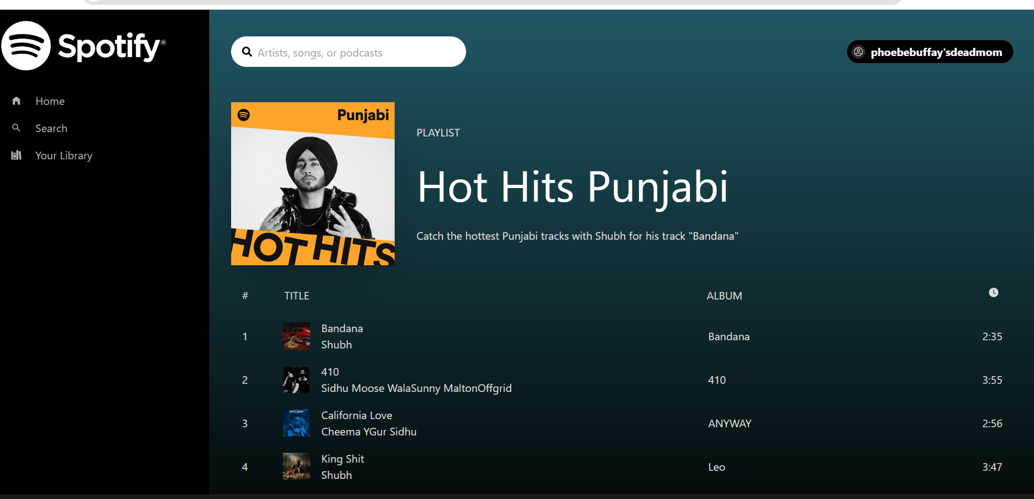
results

Slide 8
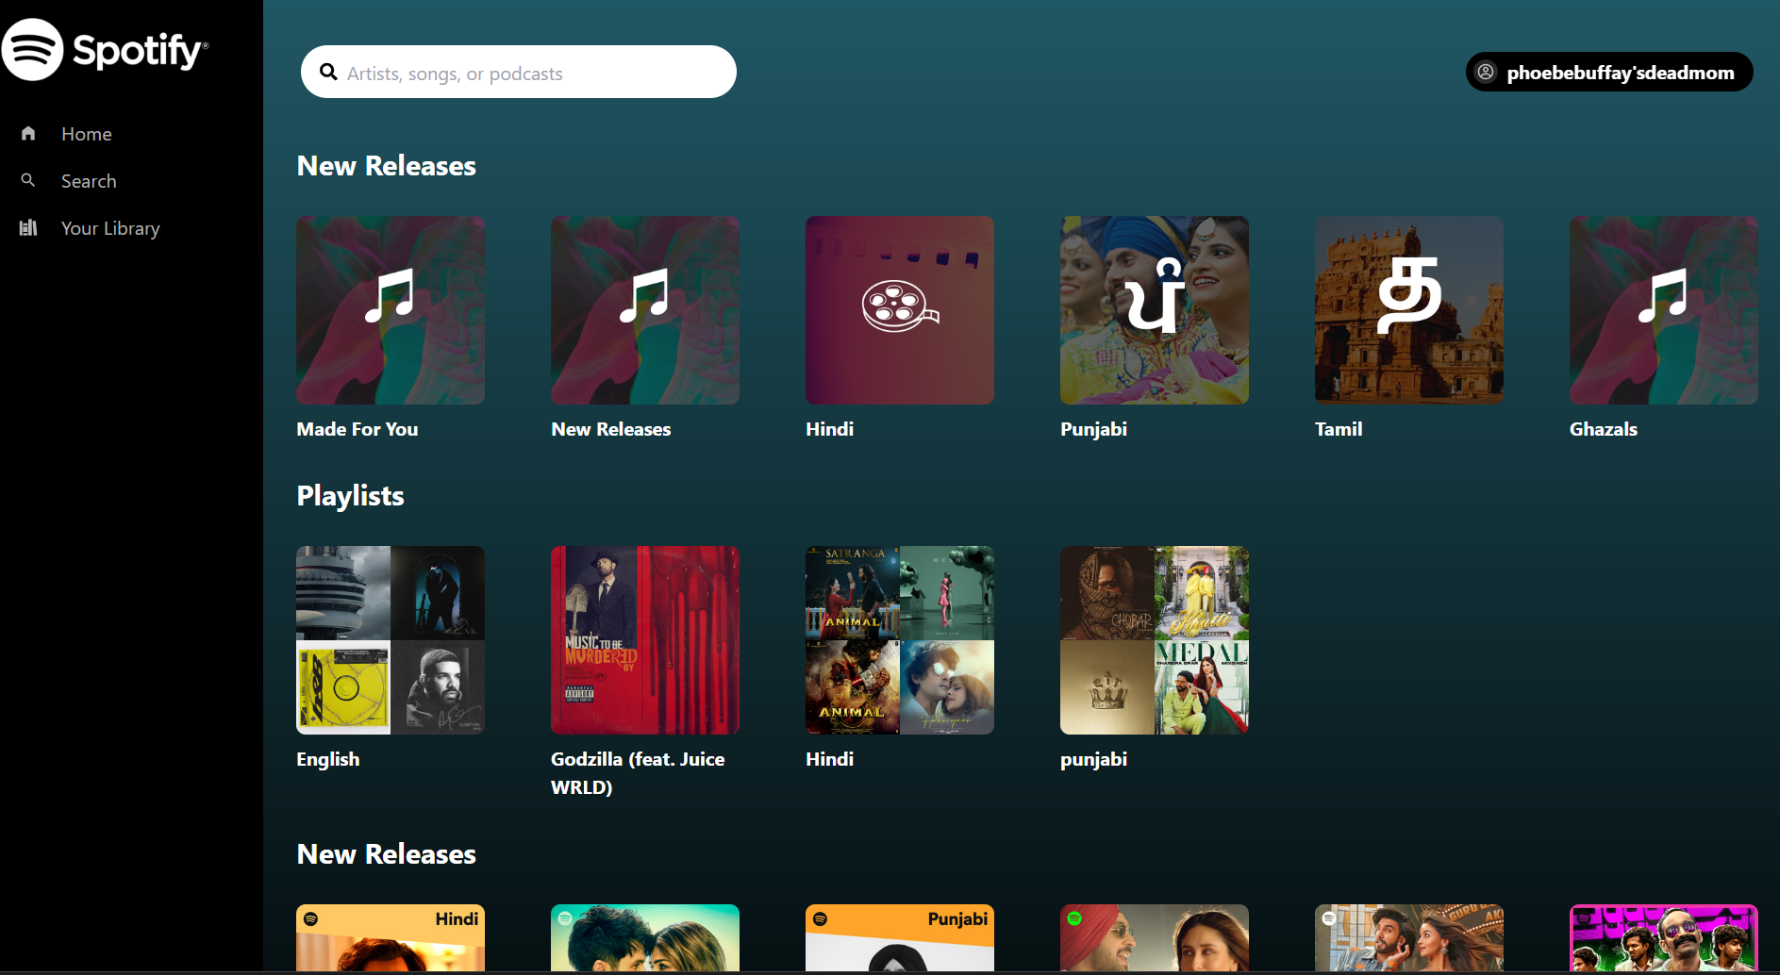

Slide 9
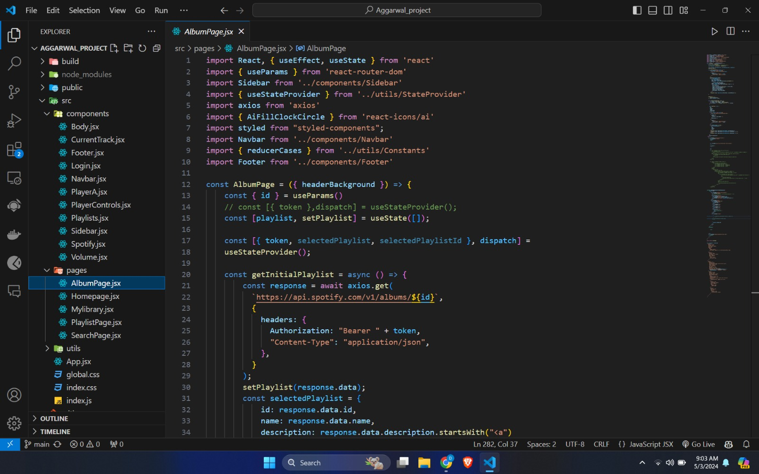
Source code

Slide 10
Future scope
• Expanding the available music library
• Providing a search option
• Providing an option to create your own playlists
• Improving support for different browsers and devices.

Slide 11
conclusion
In summary, our music player application, developed using React and seamlessly integrated with Spotify, has effectively fulfilled its mission of delivering a personalized and seamless music listening experience. The application's capability to showcase all albums within a user's Spotify library, play any track from their playlists, and effortlessly navigate between songs underscores its user-centric design philosophy."

Slide 12
references
https://www.w3schools.com/
https://legacy.reactjs.org/docs/getting-started.html
https://www.geeksforgeeks.org/.

Slide 13
Thank you

